Slide 1
It’s always DNS Now including cloud native DNS resolvers!
Leo Visser

Slide 2

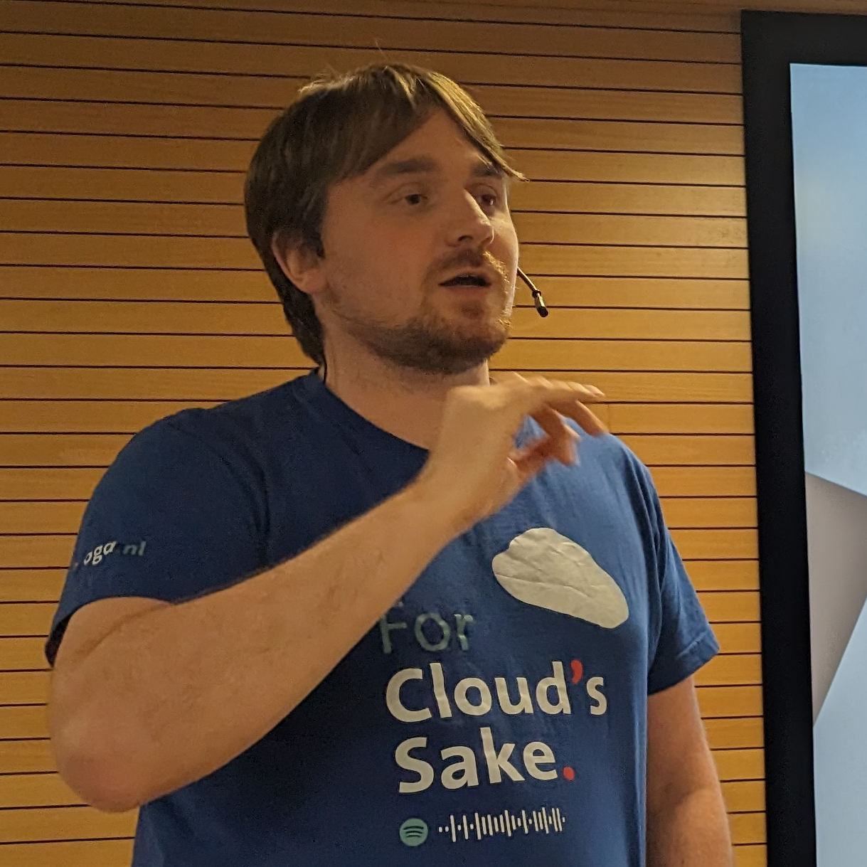
Leo Visser
Cloud Consultant @ OGD ICT-diensten
Core Infrastructure Expert
Consultant for Hybrid Environments
Blog: autosysops.com

Slide 3

Agenda
What is DNS?
DNS in Azure
Hybrid DNS
Split horizon DNS
Private DNS resolver
Notes:
Don’t forget to use the Yellenge App to give feedback
Wifi password in Yellenge app too
After this talk you all want to start using Private DNS resolver

Slide 4


What is DNS?
www.autosysops.com
A: 13.37.4.20
Notes:
Domain Name System
Phone book of the internet
Multiple types of records IPv4 and IPv6
DNSsec
Cause of many problems in IT

Slide 5


What is DNS?
domain.local
1.2.3.4
www.autosysops.com
A: 13.37.4.20
www.autosysops.com
A: 13.37.4.20
Notes:
Recursive resolver will lookup itself Authoritive Servers (often windows servers) More complex with root servers and TLD etc

Slide 6
Demo 1 recursive DNS query

Slide 7
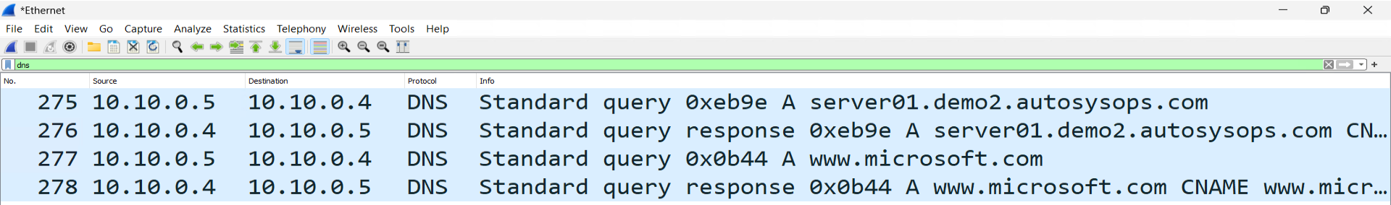
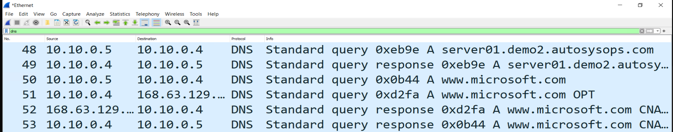
Client
Server

Slide 8

DNS in Azure
168.63.129.16
Virtual Machine
Notes:
168.63.129.16 is DNS server in All Vnets

Slide 9
Demo 2 query Azure DNS

Slide 10
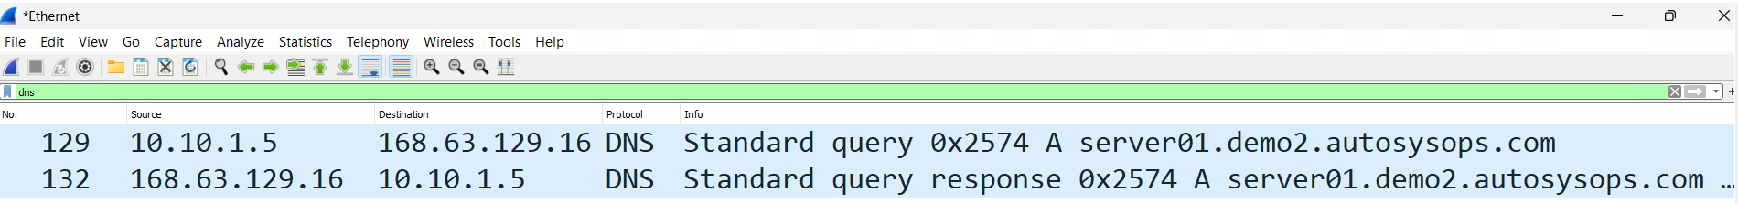
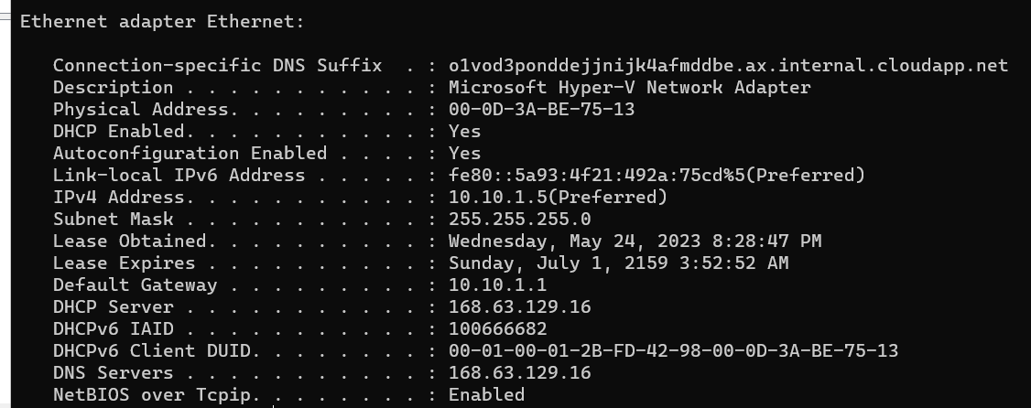
Client

Slide 11
DNS in Azure
168.63.129.16
Virtual Machine
DNS Server (forwarder)
Notes:
DNS Servers can have forwarders Azure Edition Windows Server has this default installed

Slide 12

DNS in Azure
Private DNS Zone
168.63.129.16
Virtual Machine
DNS Server (forwarder)
Notes:
Private DNS Zones can be used for private links and more
Linked to Virtual networks
Private zones have .privatelink in name
azure does some rewrite trickery
Optional: Conditional Forwarders

Slide 13
Demo 3 query Azure DNS

Slide 14
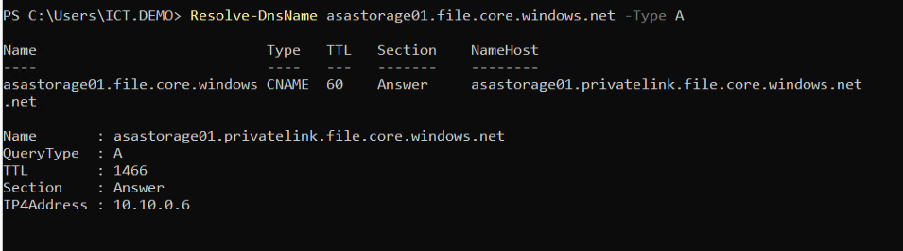
Client

Slide 15
Hybrid DNS
Private DNS Zone
168.63.129.16
VPN / Express Route
DNS Server (forwarder)
DNS Server (forwarder)
Notes:
IP of DNS is hard to route When other machines in DNS server then still missing queries

Slide 16
Hybrid DNS
Private DNS Zone
168.63.129.16
VPN / Express Route
DNS Server (forwarder)
DNS Server (Conditional forwarder)
Notes:
Use conditional forwarders to forward specific domain names to cloud servers
Lot of maintenance

Slide 17

Split horizon DNS
DNS: autosysops.com
www.autosysops.com
DC/DNS: autosysops.com
Notes:
When having domain and public DNS with same name things can go weird very soon

Slide 18

Split horizon DNS
COPY/PASTE
www.autosysops.com
DNS: autosysops.com
DC/DNS: autosysops.com
Notes:
Solution often is manage records in two paces

Slide 19
Split horizon DNS in Hybrid
Use PowerShell to deploy DNS records to servers
Deploy machines via IAC
Make sure all machines use DNS servers
Notes:
Best Solution: Deploy with PowerShell
Management of identity and network blurred due to AD also writing to DNS
Management of On-Prem and Cloud blurred due to shared infrastructure in DNS

Slide 20

Private DNS resolver
Private Resolver
168.63.129.16
Virtual Machine
DNS Server (forwarder)
Notes:
Without any setup VM will go to azure DNS which sends it to resolver which will use rules to go to right server
You can go directly to server if you want
Link resolver to Vnet
Create inbound and outbound endpoints for communication

Slide 21
Demo 4 Private DNS resolver

Slide 22
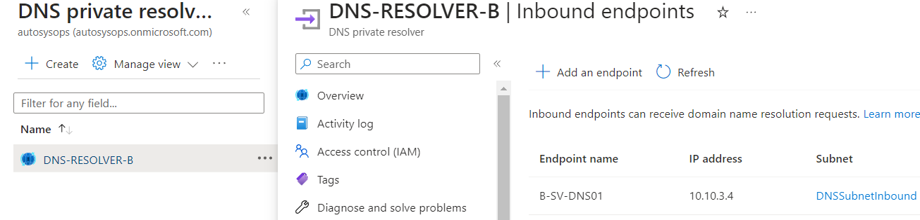
Azure – Inbound Endpoints

Slide 23
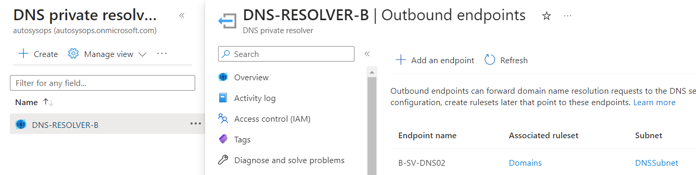
Azure – Outbound Endpoints

Slide 24
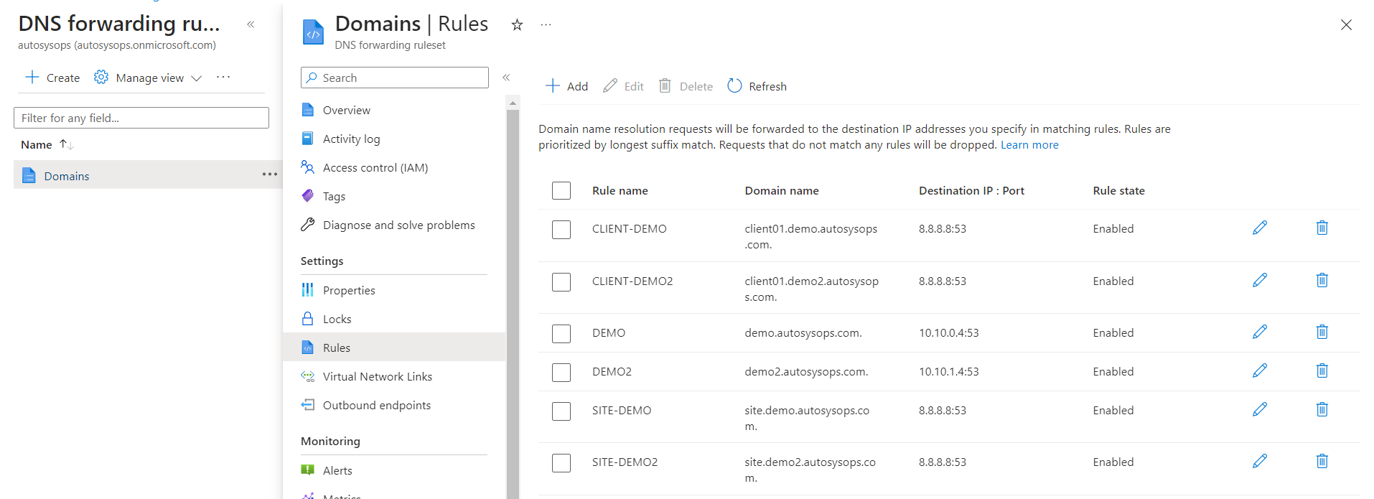
Azure - Rules

Slide 25
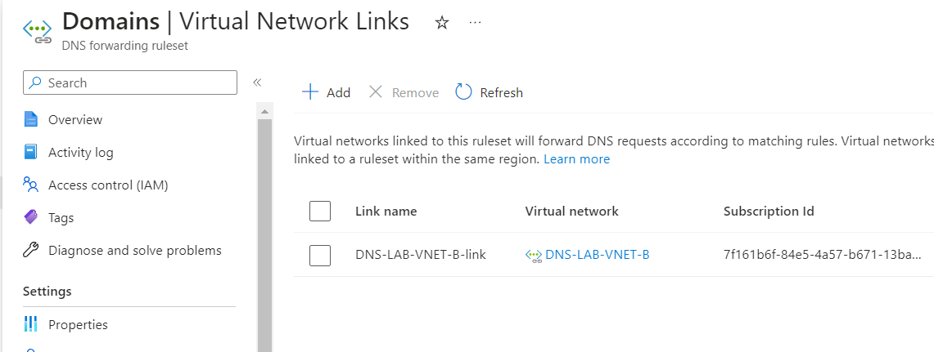
Azure – Rules Links

Slide 26
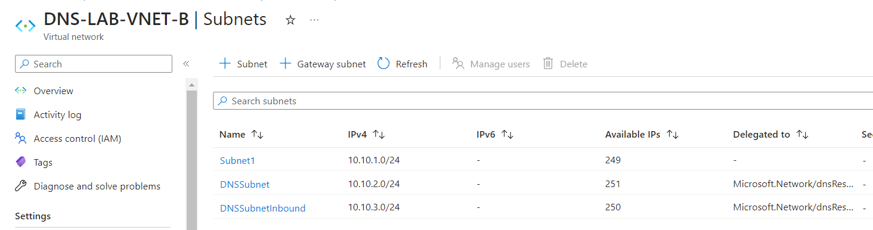
Azure - Subnets

Slide 27
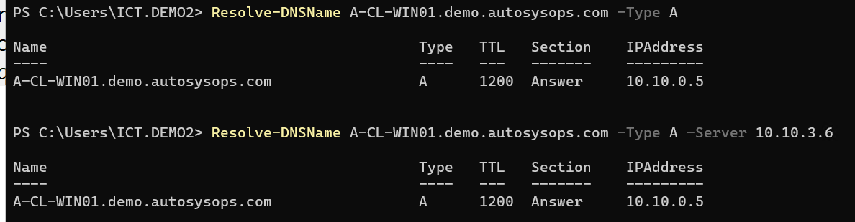
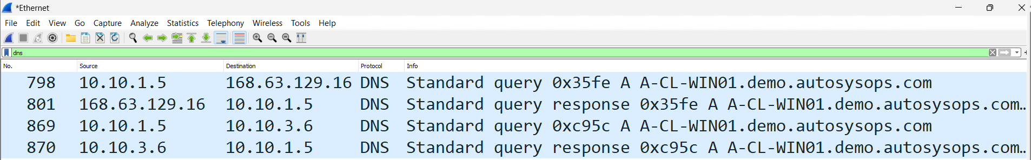
Client

Slide 28
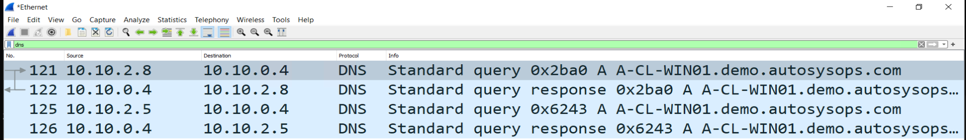
Server

Slide 29
Demo 5 Private DNS resolver Split horizon DNS

Slide 30
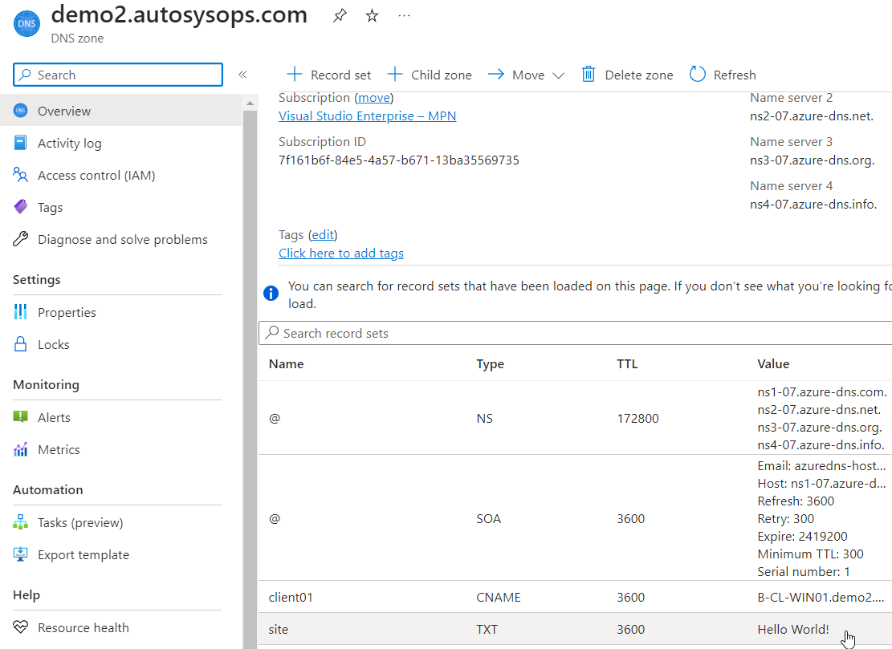
Azure – Public DNS

Slide 31
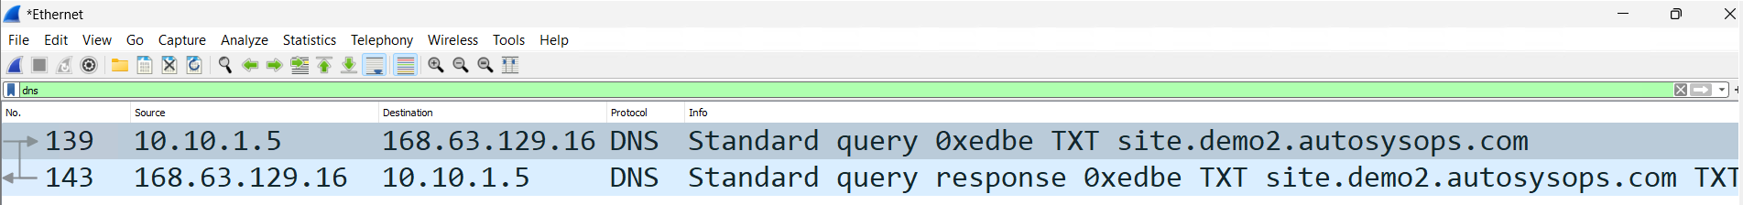
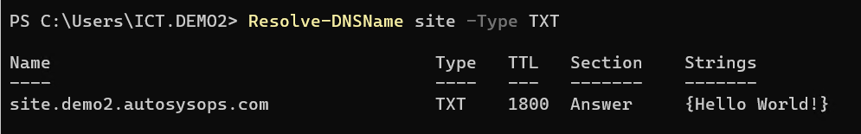
Client

Slide 32
Demo 6 Private DNS resolver Forwarding

Slide 33
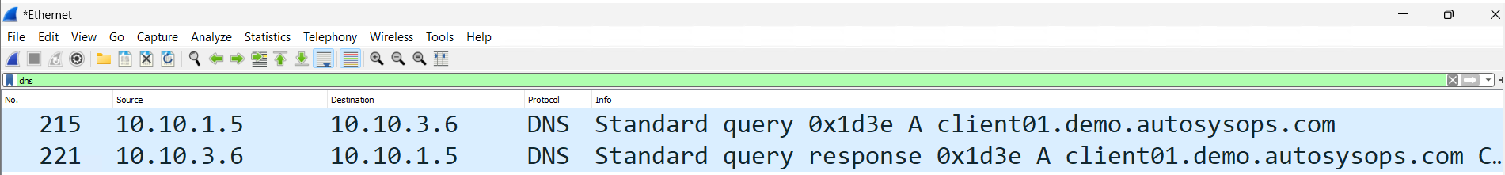
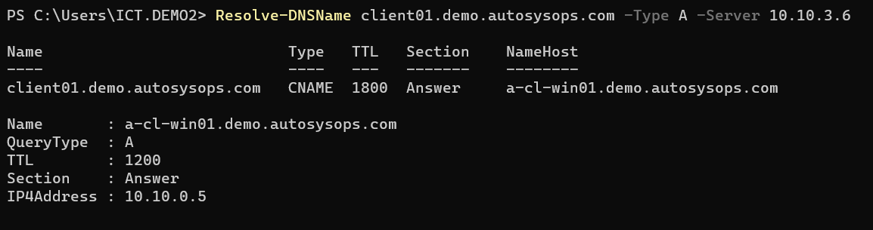
Client

Slide 34
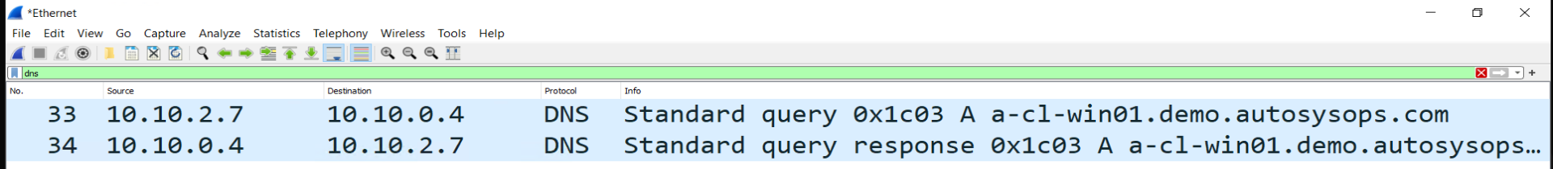
Server

Slide 35
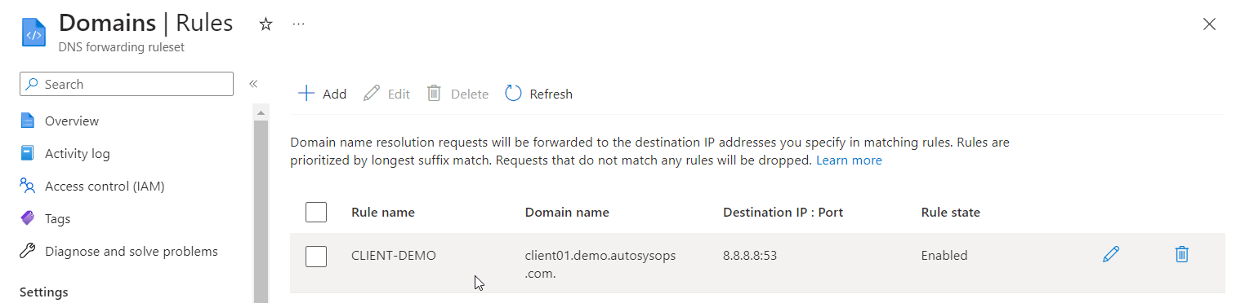
Azure - Rules

Slide 36
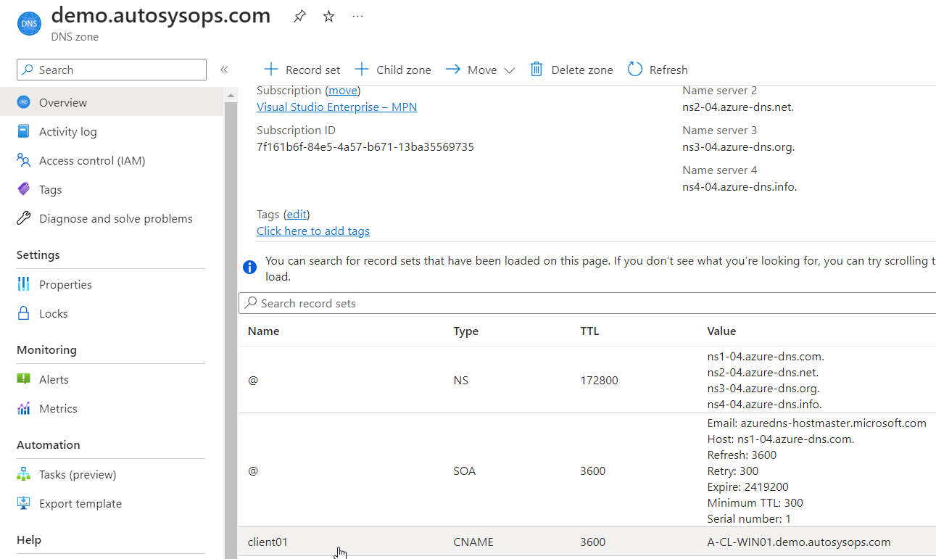
Azure - Public DNS

Slide 37
Advantages
Can be deployed by IAC (including rules)
No custom DNS required on machines
Split management between Azure and On-Prem
Possibility for AD DS DNS delegation without overlapping management
Easier On-premise routing
Notes:
Also: - Can be made HA with multiple regions

Slide 38
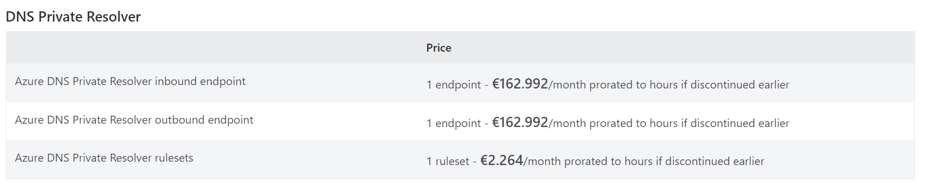
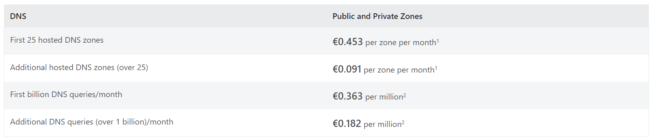
Pricing

Slide 39
Pricing
1 ruleset can have 1000 rules
Equivalent to having 2 small sized VM’s
One endpoint can server multiple Vnets

Slide 40
Questions?
Don’t forget to give feedback in the Yellenge App
Twitter: @AutoSysOps
Blog: www.autosysops.com
Sheets: github.com/autosysops/ExpertsLive2023

Slide 41
Next Session 9:00 – 9:50
Keynote: The Care and Feeding of Fusion Teams

